Slide 1



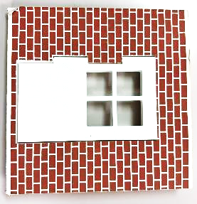
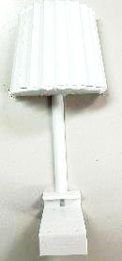
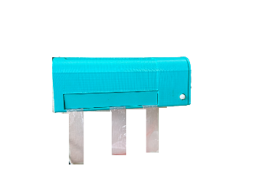
Product numbers and creating miniature EL devices
Miniature IoT unit set (Model 1)
Versatile miniature IoT device set (Model 1)
ESP32S3-DevKitC-1
Miniature EL door firmware (GitHub)
Miniature IoT door unit (Model 1)
Versatile miniature
IoT door device
Miniature EL door device
ESP32S3-DevKitC-1
Miniature EL lighting firmware (GitHub)
Miniature IoT lighting unit (Model 1)
Versatile miniature
IoT lighting device
Miniature EL lighting device
ESP32S3-DevKitC-1
Miniature IoT air-conditioner unit (Model 1)
Miniature EL air-conditioner firmware (GitHub)
Versatile miniature
IoT air-conditoner device
Miniature EL air-conditioner device

